Slide 1


child helpline system Lesotho
Project Closure Report

Slide 2
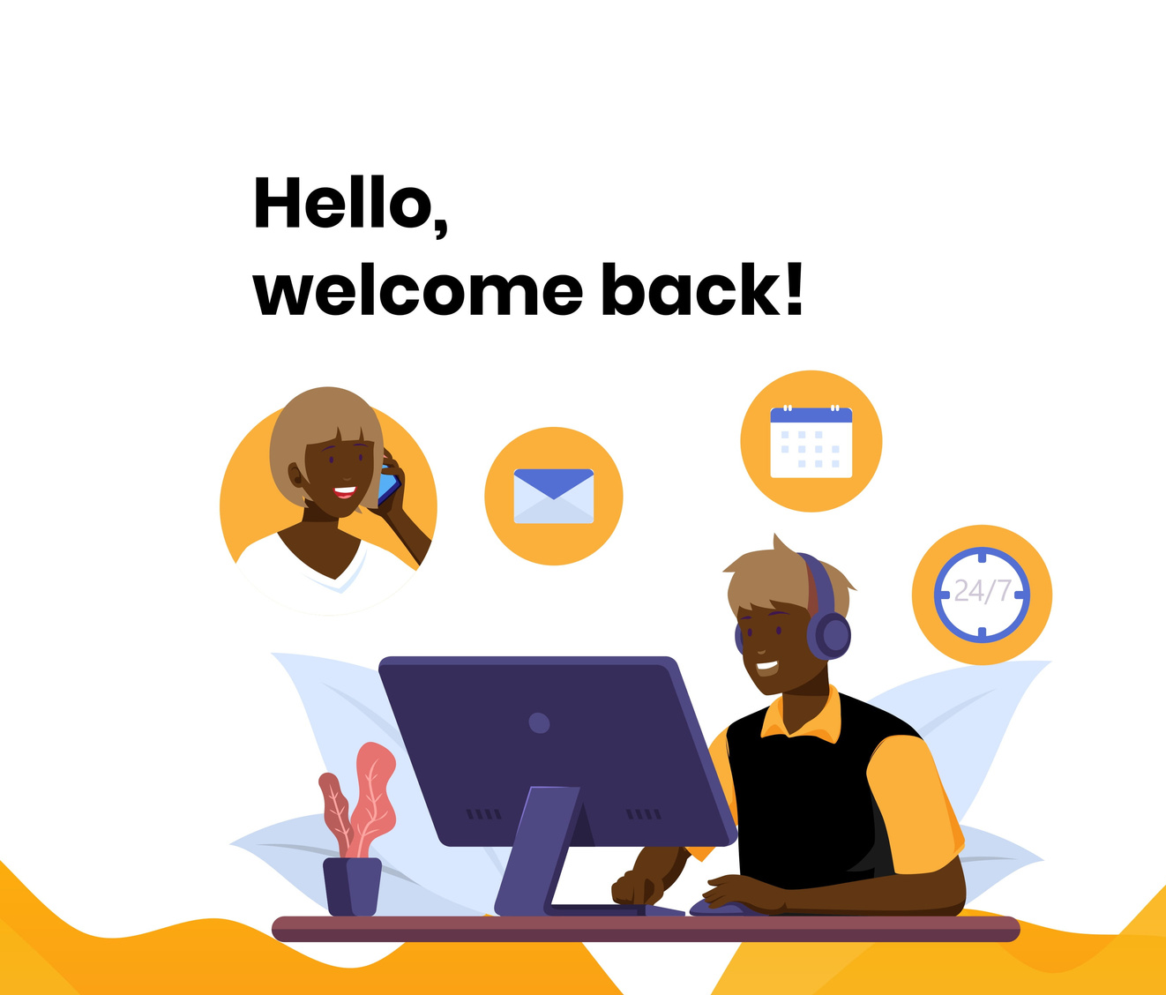
RK
Today's Agenda
OVERVIEW
Heat-map
Project Milestones
Scope Statement
Project Challenges
Risks & Recommendations
Retrospective
Transfer of Operations

Slide 3
100
75
50
Project Health Status
25
0
Inception Weekt
Customization Week
Deployment Week
User Training ( UAT)
Project Handover
Signoff/Handover

Slide 4
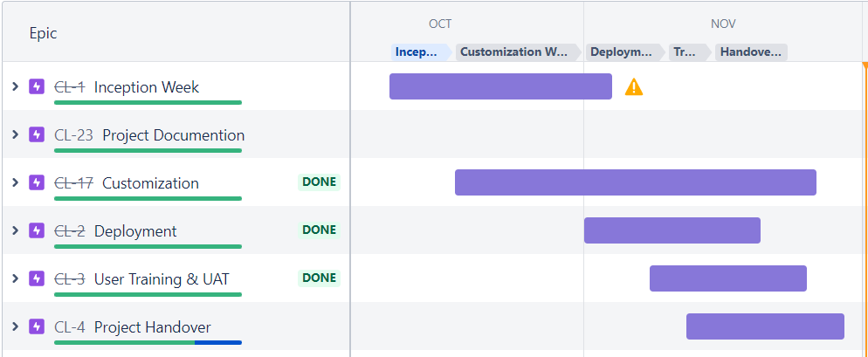
Project milestone

Slide 5
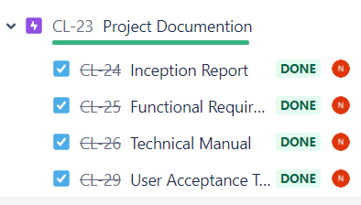
Project Documentation

Slide 6
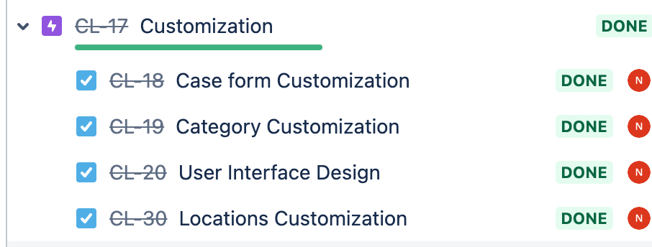
Customization

Slide 7
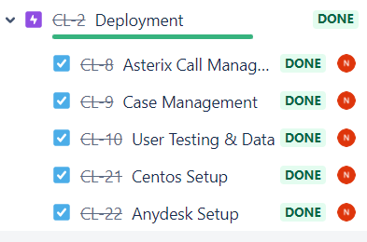
Deployment

Slide 8
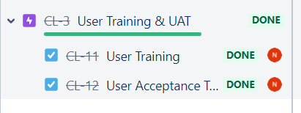
User Training& UAT

Slide 9
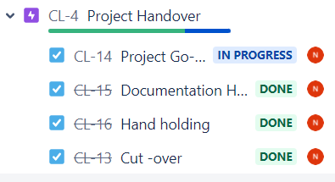
Go live activities

Slide 10

The system should be able to receive calls for VAC on the toll free number through an E1 channel.
Scope Item
SIP Technology

Slide 11
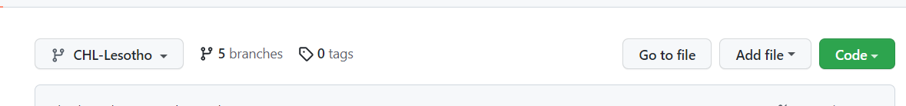
The system should be developed based on open-source standards and technologies. The process shall be managed and code shared on a code repository such as GitHub with clear documentation on deployment and integrations.
PHP/ & Native JS
Scope Item
GitHub Repository Provisioned

Slide 12
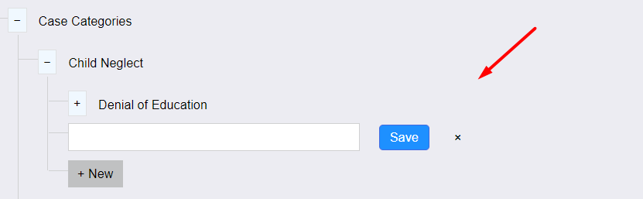
System is Customizable
Scope Item

Slide 13
API Documentation has been provided in the technical documentation.
Scope Item

Slide 14
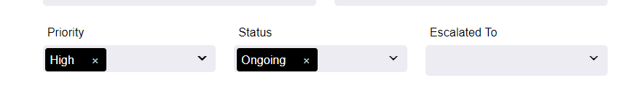

Case Management
Scope Item

Slide 15
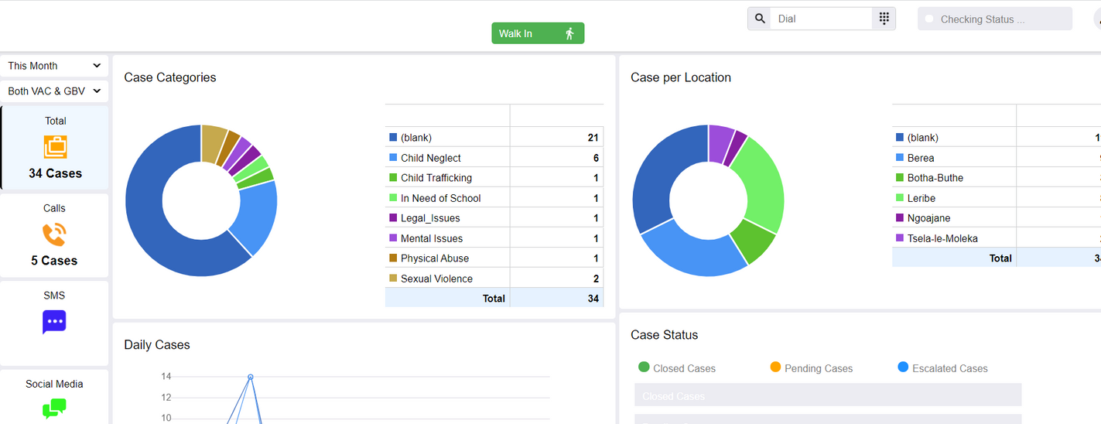
DashBoard Reports
Scope Item

Slide 16
DashBoard Reports
Scope Item

Slide 17
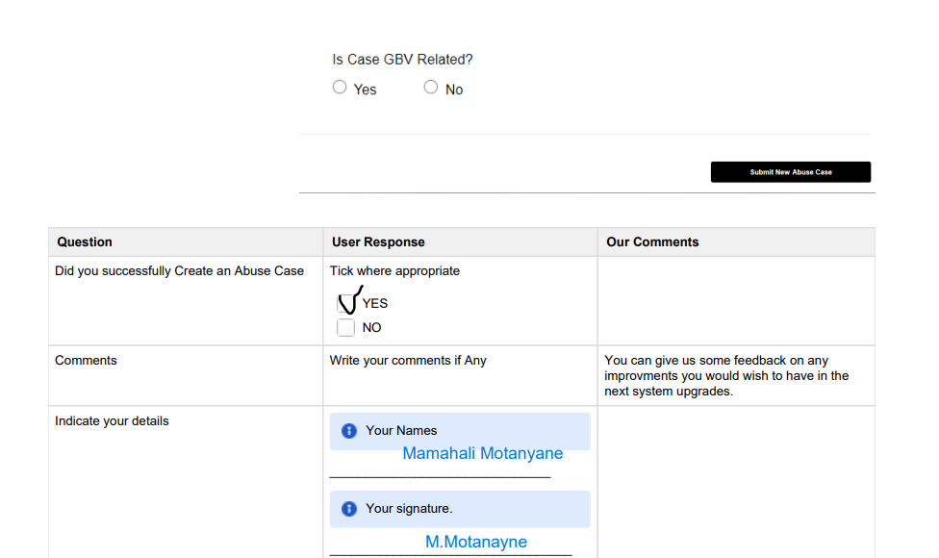
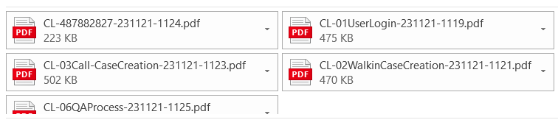
UAT Training
Scope Item

Slide 18
Backup Concept
Scope Item
Backup Concept Is being worked on and will be Implement During the Maintenance Period

Slide 19
SSL & PUBLIC IP
Scope Item
The server will be hosted at the Ministry, The SSL & Public IP will also be provided by the ministry

Slide 20
Project Duration
Challenges
Infrastructure Readiness

Slide 21
Hardware Failure
If the hardware fails, the helpline can experience a total loss of Data. Our team together with IT must ensure daily replication & backup of the server. Regularly scheduled drills will be conducted to verify the quality of the data integrity.
Telephony Failure
Sometimes due to Internet Issues or Equipment, the calls may malfunction. The center is advised to always have a GSM VoIP PABX ready to connect to the server. This will ensure that the system has adequate up-time.
Security Breach
The ministry is requested to ensure that the server is protected from possible security breaches by installing a firewall that automatically filters out know hackers.
Data privacy violation.
The system tries to restrict data only to creators, however, in cases where our restriction has been bypassed. The SPOC (single point of contact can inform us by raining a ticket.
Risks & Recommendations

Slide 22
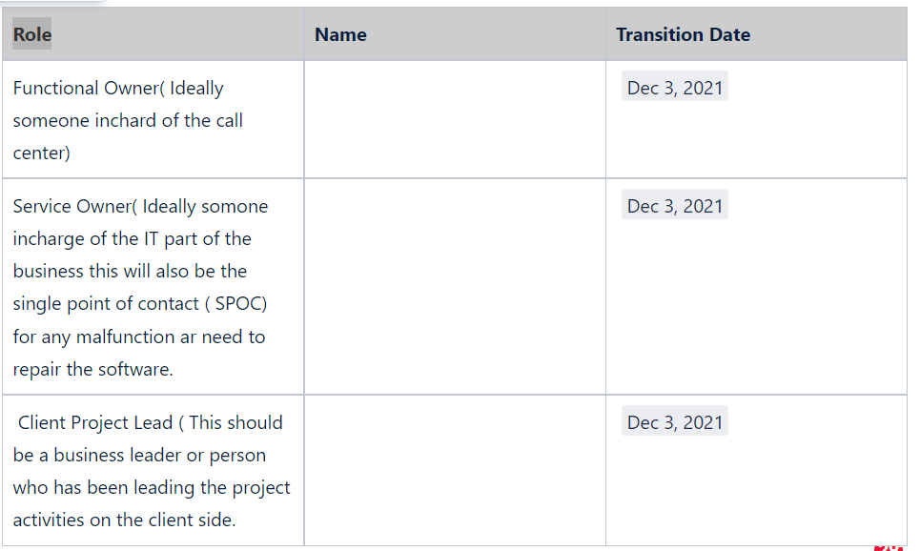
Transfer Operations

Slide 23

Contact Us
Reach out to us for
inquiries or comments.
+254 720 055 067
Phone Number
info@bitz-itc.com
Email Address
www.bitz-itc.com
Website

